Slide 1
Unit 2: The Arab World The Iraq War

Slide 2
Iraq is one of the largest oil resources in the world, with proven reserves of 120+ billion barrels of oil, second only to Saudi Arabia.
This simple fact has shaped Iraq's relationship with the rest of the world.

Slide 3
At the heart of the conflict… RELIGION
Shiite vs. Sunni
In the midst of a civil war
A fight for political power
Rivalry, hatred, death and destruction

Slide 4
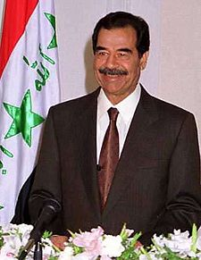
Background: Saddam Takes Power
Iraq is made up of mostly Shiites.
1979: Saddam Hussein, a Sunni, became dictator
His regime greatly oppressed the Shia majority in Iraq.
United States actually supported Hussein during the 1980s.
WHY? Iraq was fighting a war against Iran.
Iran: Shiite Government
Iraq: Sunni Government
Saddam Hussein
President of Iraq, 1979-2003

Slide 5
SADDAM HUSSEIN
Modern, western government
Sold oil to US
Secular, laws not based on Koran
Sunni Arab
Known support of terrorists (Abu Nidal)
Wanted to make Iraq the leading state in the Middle East

Slide 6
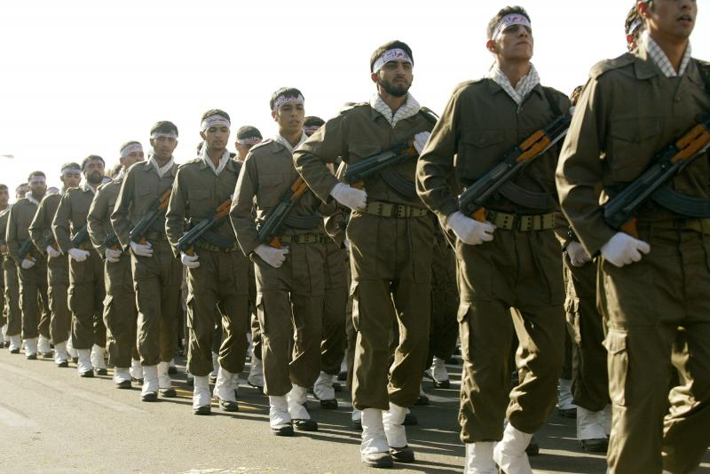
Iran-Iraq War: 1980-1988
Horrific trench warfare, massive casualties (over 1 million)
Allegations of Iraqi use of chemical weapons on both Iranians and Iraqi Kurds
Ended as a stalemate, although Saddam claimed victory (built the “Hands of Victory” monument pictured on right)
Massive war debts for Iraq and Iran

Slide 7
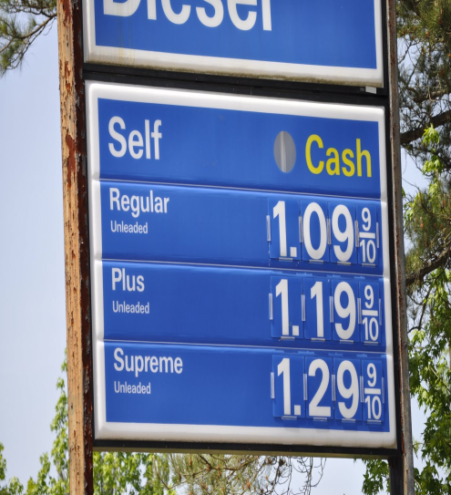
Effects of Iran-Iraq War
As the war ended in 1988, Iraq was in crisis.
Iraq had $60 billion to repay to foreign banks,
It could no longer pay for the health care, education, nearly-free food and gas, and other benefits given to its citizens in better times,
The price of oil had fallen sharply,
crippling Iraq’s ability to repay its wartime debts.

Slide 8
Desert Shield and Desert Storm
First Persian Gulf War

Slide 9
Desert Storm: Background
Long-standing disputes between Iraq and Kuwait.
Iraq wants Kuwait to forgive debts Iraq owes from Iran-Iraq War.
Claims Kuwait actually owes Iraq for “defending” it against Iran.
Iraq accuses Kuwait of overproduction of oil/theft of Iraqi oil.
On Aug 2, 1990, Iraq invaded Kuwait

Slide 10
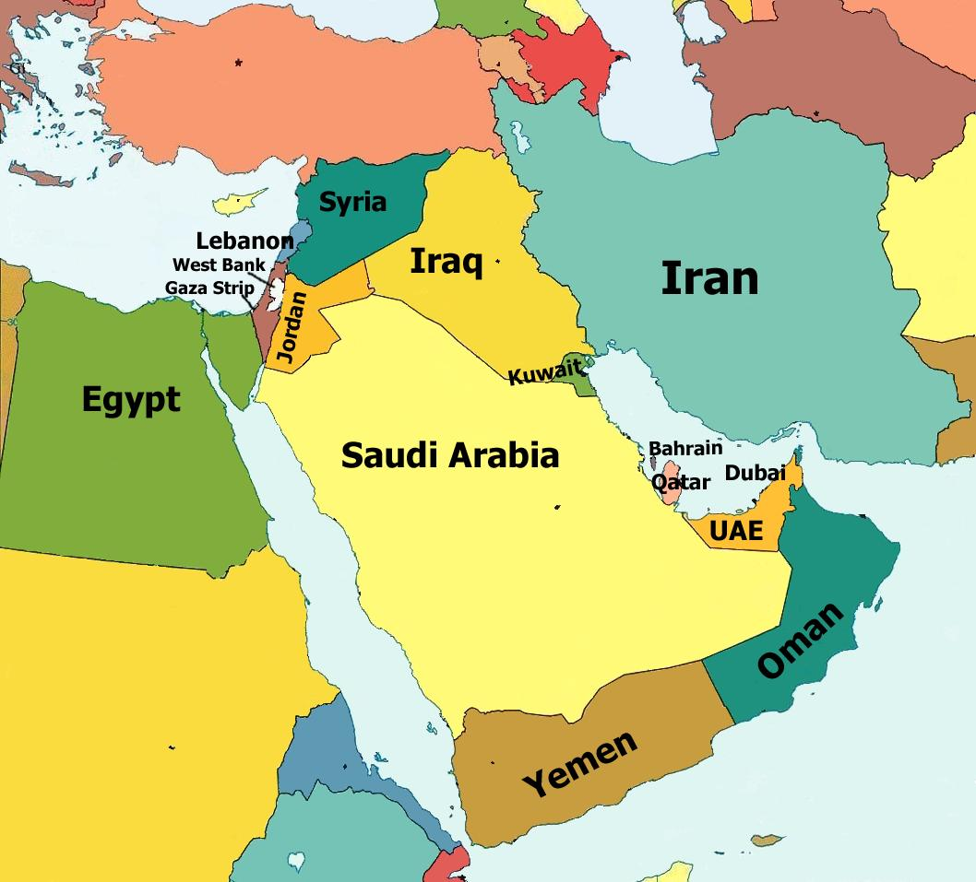
Persian Gulf War (1991)
In 1990, Saddam Hussein, invaded the small country of Kuwait
Hussein’s goal: Use Kuwait’s oil wealth to help make Iraq the dominant power in the Middle East.
Saudi Arabia, fearing invasion, asked the United States for military aid.
Remember, Mecca is in Saudi Arabia!
The U.S. and its allies gave Hussein an ultimatum, which he ignored.
U.S. forces then defeated the Iraqi army and forced it to leave Kuwait.

Slide 11
Iraq: Results of The Persian Gulf War
Saddam Hussein remained in power in Iraq.
Because Saddam refused to accept U. N. terms for peace, the U. N. placed an embargo on Iraq.
Iraq’s economy suffered as a result of the embargo.
600 oil fields in Kuwait were set on fire with devastating environmental effects.

Slide 12
Effects of First Persian Gulf War
Global forces encouraged Iraqi uprisings
Kurds rose up in the north, Shia Arabs in the south but not supported externally
No fly zones established
Sanctions imposed
Food for oil program initiated
Saddam remained deeply entrenched
Civilians suffered miserably

Slide 13
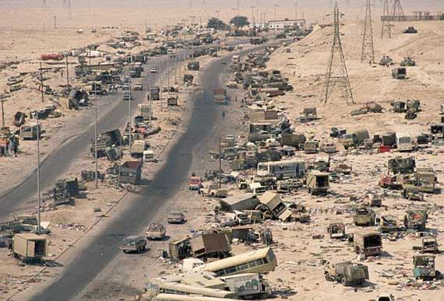

Slide 14
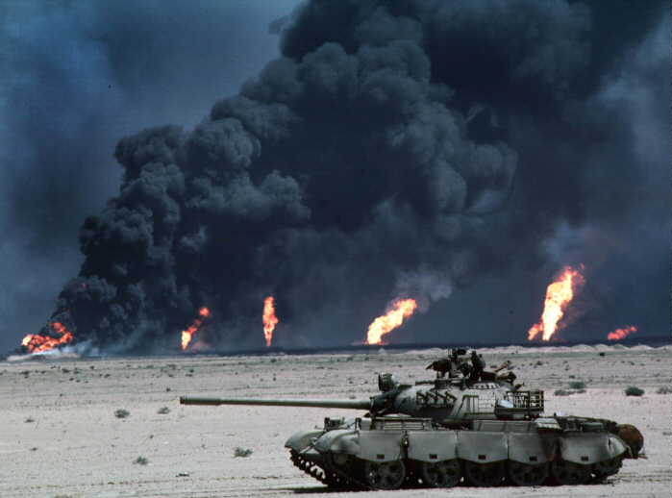

Slide 15
Second Iraq War

Slide 16
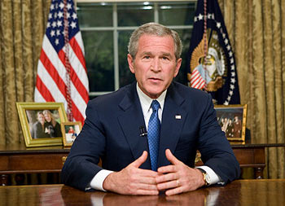
Bush Doctrine
The United States will attack first against any nation that poses a threat to the security of the United States or its allies

Slide 17
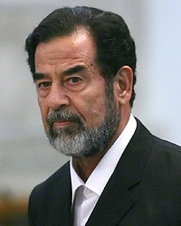
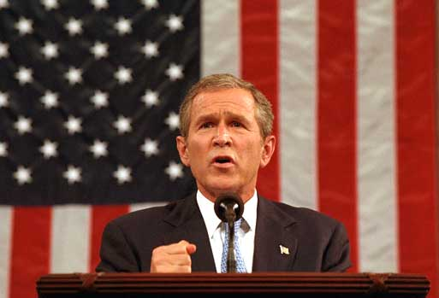
Fast-forward to 9/11 . . .
Hussein had been allowed to stay in power in 1991.
The U.S. and its allies did not want to have to build a new government in Iraq at that time.
In 2002, President George W. Bush pushed for an invasion of Iraq. He claimed Iraq had
WMDS (Nukes, Bio, Chem)
Connections to Al Qaeda
Many other nations wanted more of an investigation before invading Iraq
U.S. invaded in March, 2003

Slide 18
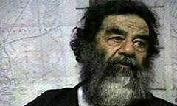
Leading Up To War
United States identifies Iraq as a threat
Broke cease fire agreement 17 times
Repeatedly kicked weapons inspectors out of Iraq
Police once held inspectors in parking lot for 2 days at gunpoint
US points to evidence that Saddam is developing Weapons of Mass Destruction (WMD’s)
Could be used against Israel or sold to terrorists
President Bush declares Saddam Hussein a threat to the safety of the United States
Issues Feb. 2003 as deadline for Saddam to step down from power
Deadline ignored

Slide 19
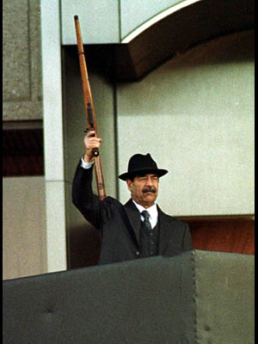
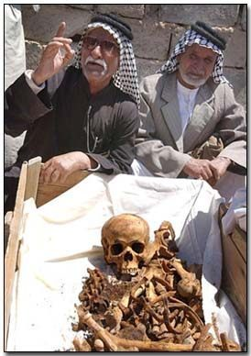
Reasons given for invasion of Iraq:
Fear of “Weapons of Mass Destruction”
(Destroy them before they can be used on the U.S.)
Saddam Hussein’s “human rights” abuses
To spread Democracy and improve the life of the Iraqi people

Slide 20
The 2003 invasion of Iraq, code-named "Operation Iraqi Freedom" by the United States, officially began on March 20, 2003.
Objective: "to disarm Iraq of weapons of mass destruction, to end Saddam Hussein's support for terrorism, and to free the Iraqi people.”

Slide 21
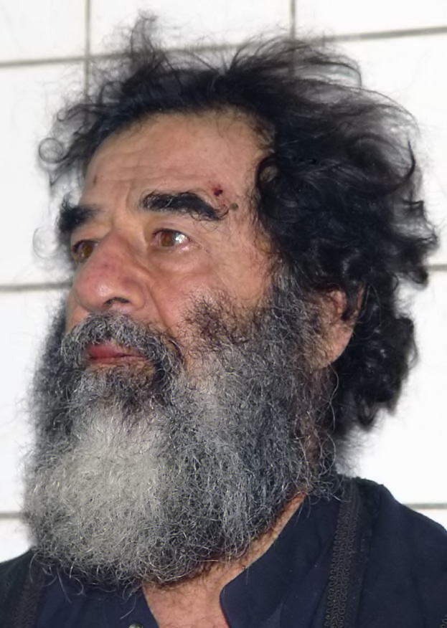
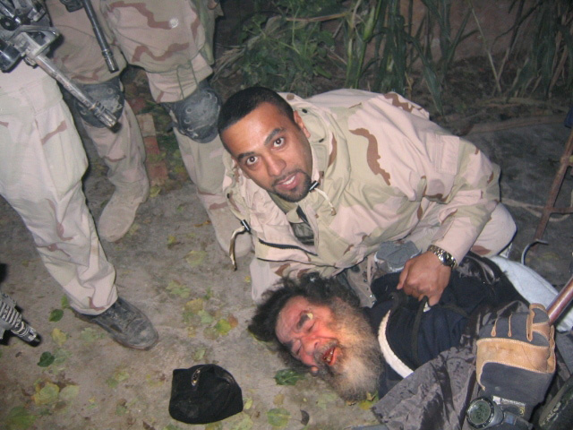
Iraq War (2003-2011)
Saddam Hussein was easily defeated (2003) & later executed (2006) by new Iraqi government.
No WMDs were found
No connection to al Qaeda was found
The United States had to stay in Iraq for 8 years in an attempt to create a new, stable government.

Slide 22
Coalition Government
Meanwhile, coalition worked to create new, democratic government in Iraq
2004, power transferred to Iraqis
2005, Iraqis voted in country’s first multiparty election in fifty years
Later approved new constitution to make Iraq Islamic federal democracy
Continued violence, potential for civil war made country’s future highly uncertain

Slide 23
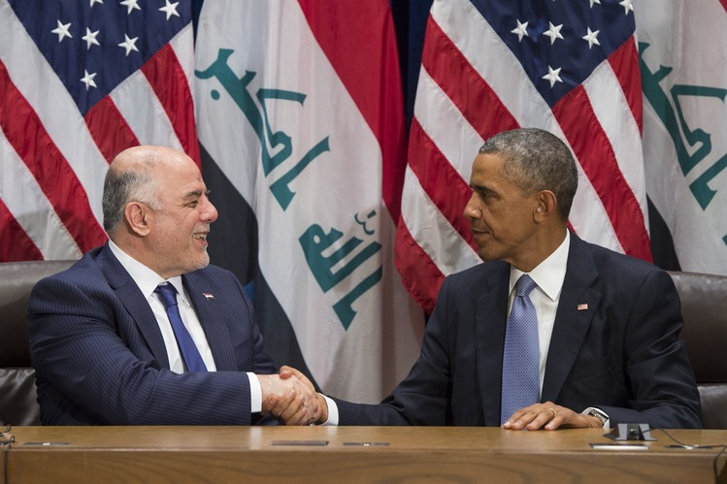
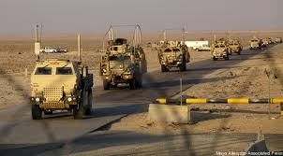
Iraq Today
A (shaky) democratic government does exist in Iraq.
American troops left Iraq in 2011.
President Obama (USA) &
Prime Minister Haider al-Abadi (Iraq)

Slide 24
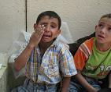
As of 2009, a majority of American citizens see the Iraq War as a waste of the last 6+ years, a waste of the 4,000 American soldiers killed, believe Iraq has nothing to do with the “War on Terror,” and believe we should remove our soldiers from the country immediately.
However, others say one of the main reasons we have not had another Sept. 11th attack is because we removed Saddam Hussein from power before he had the chance to harm the United States, and believe that we should stay in Iraq until it is safe – no matter how long that takes.

Slide 25
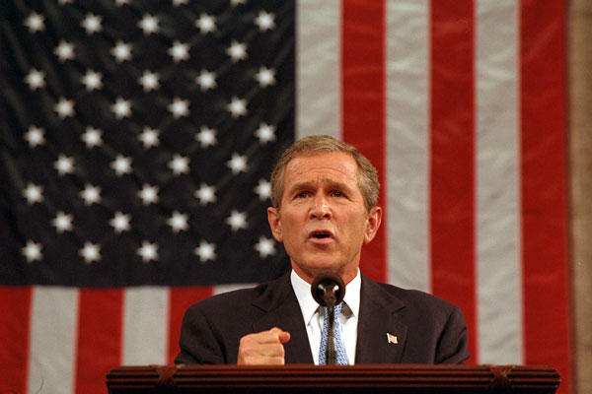
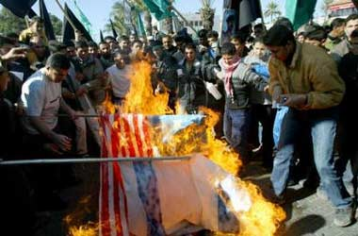
In 2003, nearly 85% of American citizens, and Congress, supported the invasion of Iraq.
In 2009, about 20% of American citizens support the current invasion of Iraq.
Why the change?

Slide 26
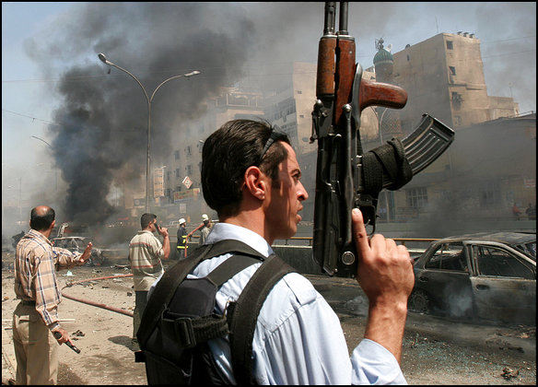
No WMDs were ever found.
Iraqi suicide bombers (loyal to Saddam Hussein) continue to interfere with any progress the U.S. makes in Iraq.
Fewer Iraqi citizens support us than in 2003. (Don’t see enough progress)
The new democratic Iraqi gov’t continues to have problems.

