Slide 1
Dynasties of China

Slide 2
Shang (1700-1027 BC) (Hammurabi, Hittites, Olmec)
First recorded Dynasty (Xia-no written records)
•Ruled by aristocracy: were of the warrior class
•created silk by using silk worms
•Honored ancestors: They had connection to the gods
Used oracle bones: first writing etched
Shang authority:
bronze vessels for sacrifices to the gods
Horse-drawn chariot
Trade networks

Slide 3
Shang Dynasty

Slide 4
Chou (Zhou) (1027-250 BC) Persia & Greece
Longest lasting Chinese Dynasty
Beginning of Mandate of Heaven: wise, and good care-taker
Early: Feudal system, lords had total authority
Later: City-states
Separation of religion from political dealings: developed important secular philosophies

Slide 5
Zhou Dynasty

Slide 6
Chou (Zhou) (1027-250 BC)
Daoism and Confucianism introduced
Confucius: Family is fundamental to society & individual freedom!
Yin & Yang: male and female roles in the natural order
Decline: Inefficient rulers can’t control fighting between city-states
Period of Warring States

Slide 7
Qin (221-207 BC) (Rome & Carthage)
Qin Shi Huangdi (first emperor): first & only emperor
Adopted Legalism: strict rules of punishment
Standardized currency, language, measurements, laws
Built first Great Wall
Women--lived with the husband's family

Slide 9
Qin (221-207 BC)
Brutal ruler executed dissenters, burned books
Cracked down on Confucians: freedom
Many enemies, dynasty falls after his death
Buried in his elaborate tomb

Slide 10
Where they think Qin is Buried!

Slide 11
Guarding His Tomb: Terracotta Warriors—Pit 1

Slide 12
Han (202 BC-221 AD) (Roman Empire)
Legalism replaced by Confucianism
Introduced civil service examination (scholar gentry)
Silk Roads developed, opens trade
Capital city was Chang'an, urban, well-planned

Slide 14
Han (202BC-221AD)
Buddhism introduced, paper invented
Great increase in population, landholdings
Nomadic raiders
Corruption, weak leaders
Han make up 90% of the people

Slide 15
Roman Vs. China

Slide 16
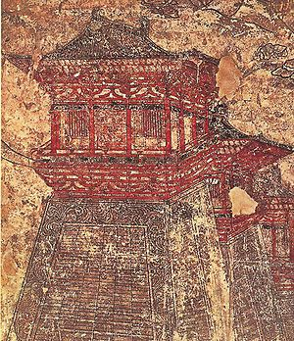
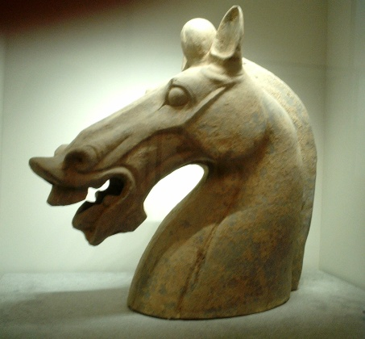
Chang’an: Han Capital

Slide 17
Liu Sheng Tomb (113 BC
Jade suit has 2,498 pieces

Slide 18
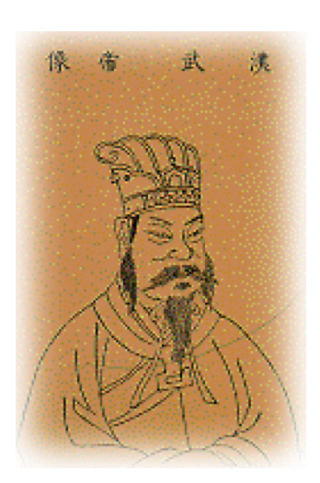
Life under Wu Di: Power in 141 BC
Had defense on the Great Wall using smoke and flag signals
Regular mail delivery
Trained police dogs
Developed the Silk Road

Slide 19
The Silk Road

Slide 20
General Ban Chao: Han General and Colonial Administrator
1. Smooth communications along Silk Road
2. Aware of Rom--China and Rome both consider themselves the center of the universe
3. Began to trade silk through Persia to Rome

Slide 21
221-581(AD)
War lords control China-no centralized gov’t
•Non-Chinese nomads control much of China
•Buddhism becomes popular-Confucianism failed

Slide 22
Sui (581-618AD) (Rome in Shambles--Germanic)
Completed Grand Canal
High taxes, forced labor: public works expensive
Military failures (couldn’t conquer Korea)--overextend in territory
Assassination ends dynasty

Slide 23
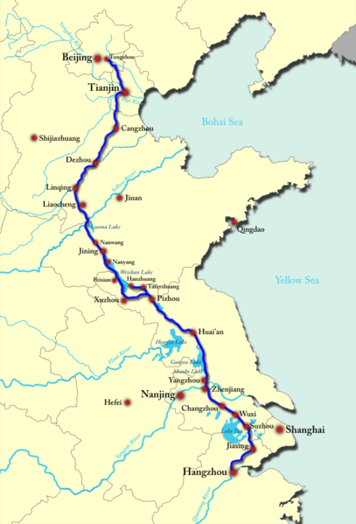
The Grand Canal

Slide 24
The Grand Canal Today

Slide 25
Sui Dynasty

Slide 26
Tang (618-907AD) (Maya, Anasazi, Charlemagne, Kiev & Christianity)
High point of Chinese culture: cosmopolitan-trade, different cultures accepted
Invention of movable print, gunpowder
Tributary system: acknowledged supremacy of the emperor

Slide 28
Tang (618-907 AD)
Wu Zetian-Only Empress in Chinese history
Decline
Weak emperors, nomadic incursions, economic difficulties
War lords take control

Slide 29
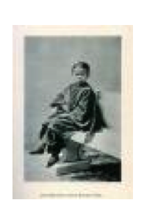
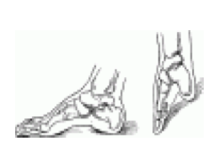
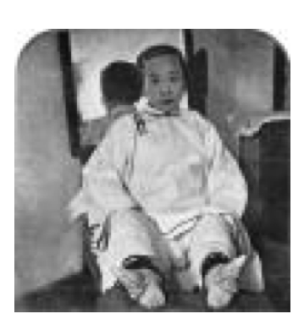
Foot Binding: Tang China
Broken toes beginning at age 3-5 years
Large toe for stabilization
In 1911, foot binding was outlawed

